Slide 1
Application
Infrastructure Projects
Middleware
EF Core
DbContext
GraphQL
Endpoints
Inventoy variables
Parser
MediatR
Handlers / Dto
Azure Provider
Controllers
Rest API
IPAM Provider
Filters / Middleware
MediatR
Unit Tests
Application Core Project
Application
Interfaces
Domain Events
Filters
Application Core
POCO Entities
Specifications
Value Objects

Slide 2





API Gateway
GrapQL Federation
Devices Domain
Users Domain
Networks Domain
Configuration API
GrapQL API
GrapQL API
GrapQL API
GrapQL API
Databases
Devices
Streaming
replication
Devices

Slide 3











Client apps
Authorization microservice
Ansible
Authorization API
SSO
Domain Account
Bearer Token
Inventory plugin
Modules
CallBacks
Event bus
Publish suscrbibe channel
IAS Web app
Networks microservice
Networks API
IPAM
Firewall rules
Firewall objects
Sharepoint lists
API Gateway
Cmdb Light
Schema Federations
Devices microservice
Devices API
Servers
Firewall
Generic
Monitoring
Health checks
Users microservice
Users API
Unix Users
Service accounts
Kerberos SPN
Kerberos delegation
Provisioning service
Devices Database
Ansible Tower Interfaces

Slide 4

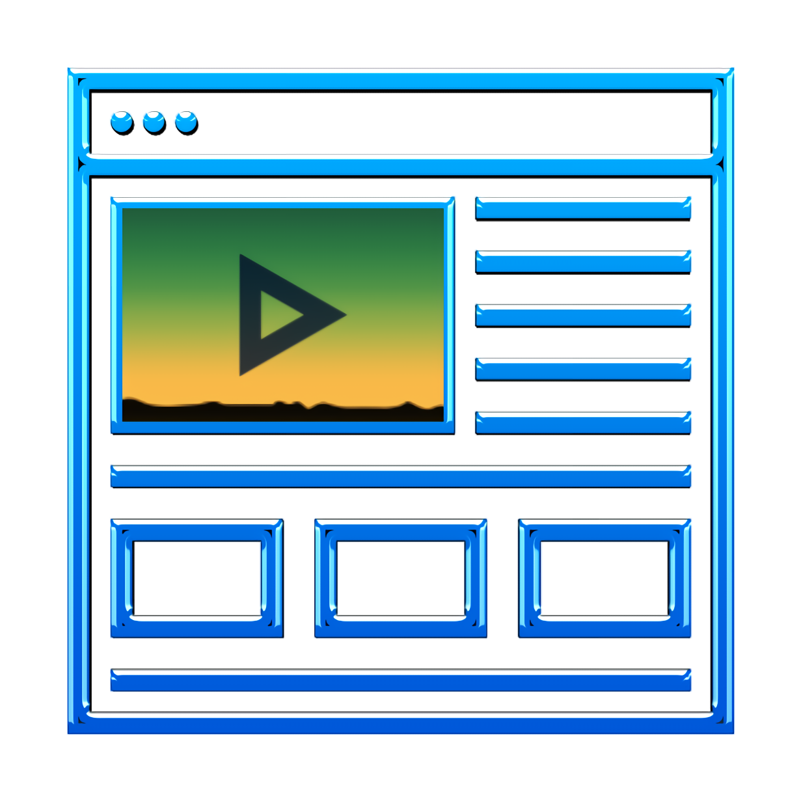





Client apps
Infrastructure Management microservices
Infrastructure On premise
Ansible
Authorization API
SSO
Domain Account
Bearer Token
Inventory plugin
Modules
CallBacks
Virtualization
platform
Devices API
Servers
Firewall
Generic
IP Addresses
Management
Self service portal
Users API
Unix Users
Service accounts
Kerberos SPN
Kerberos delegation
API Gateway
Event bus
Publish suscrbibe channel
Databases
Schema Federations
Networks API
Firewall
&
Security Tools
IPAM
Firewall rules
Firewall objects
Sharepoint lists
Devices list
Databases API
Databases
Provisioning service
Ansible Tower Interfaces
Cloud Infrastructure
Monitoring
Health checks
Web status
Logging / APM
Health check status
Logs storage
APM

Slide 5
Client apps
Infrastructure Management microservices
Infrastructure On premise
Authorization API
Backend Infrastructure
Ansible
SSO
Domain Account
Bearer Token
Inventory plugin
Modules
CallBacks
Devices API
Virtualization
platform
Servers
Firewall
Generic
Users API
Event bus
Publish suscrbibe channel
IP Addresses
Management
Self service portal
Unix Users
Service accounts
Kerberos SPN
Kerberos delegation
API Gateway
Networks API
Databases
Schema
Federations
IPAM
Firewall rules
Firewall objects
Firewall
&
Security Tools
Sharepoint lists
Databases API
Databases
Devices list
Logging / APM
Provisioning service
Logs storage
APM
Ansible Tower
Interfaces
Cloud Infrastructure
Monitoring
Health checks
Web status
Health check
status

